Slide 1
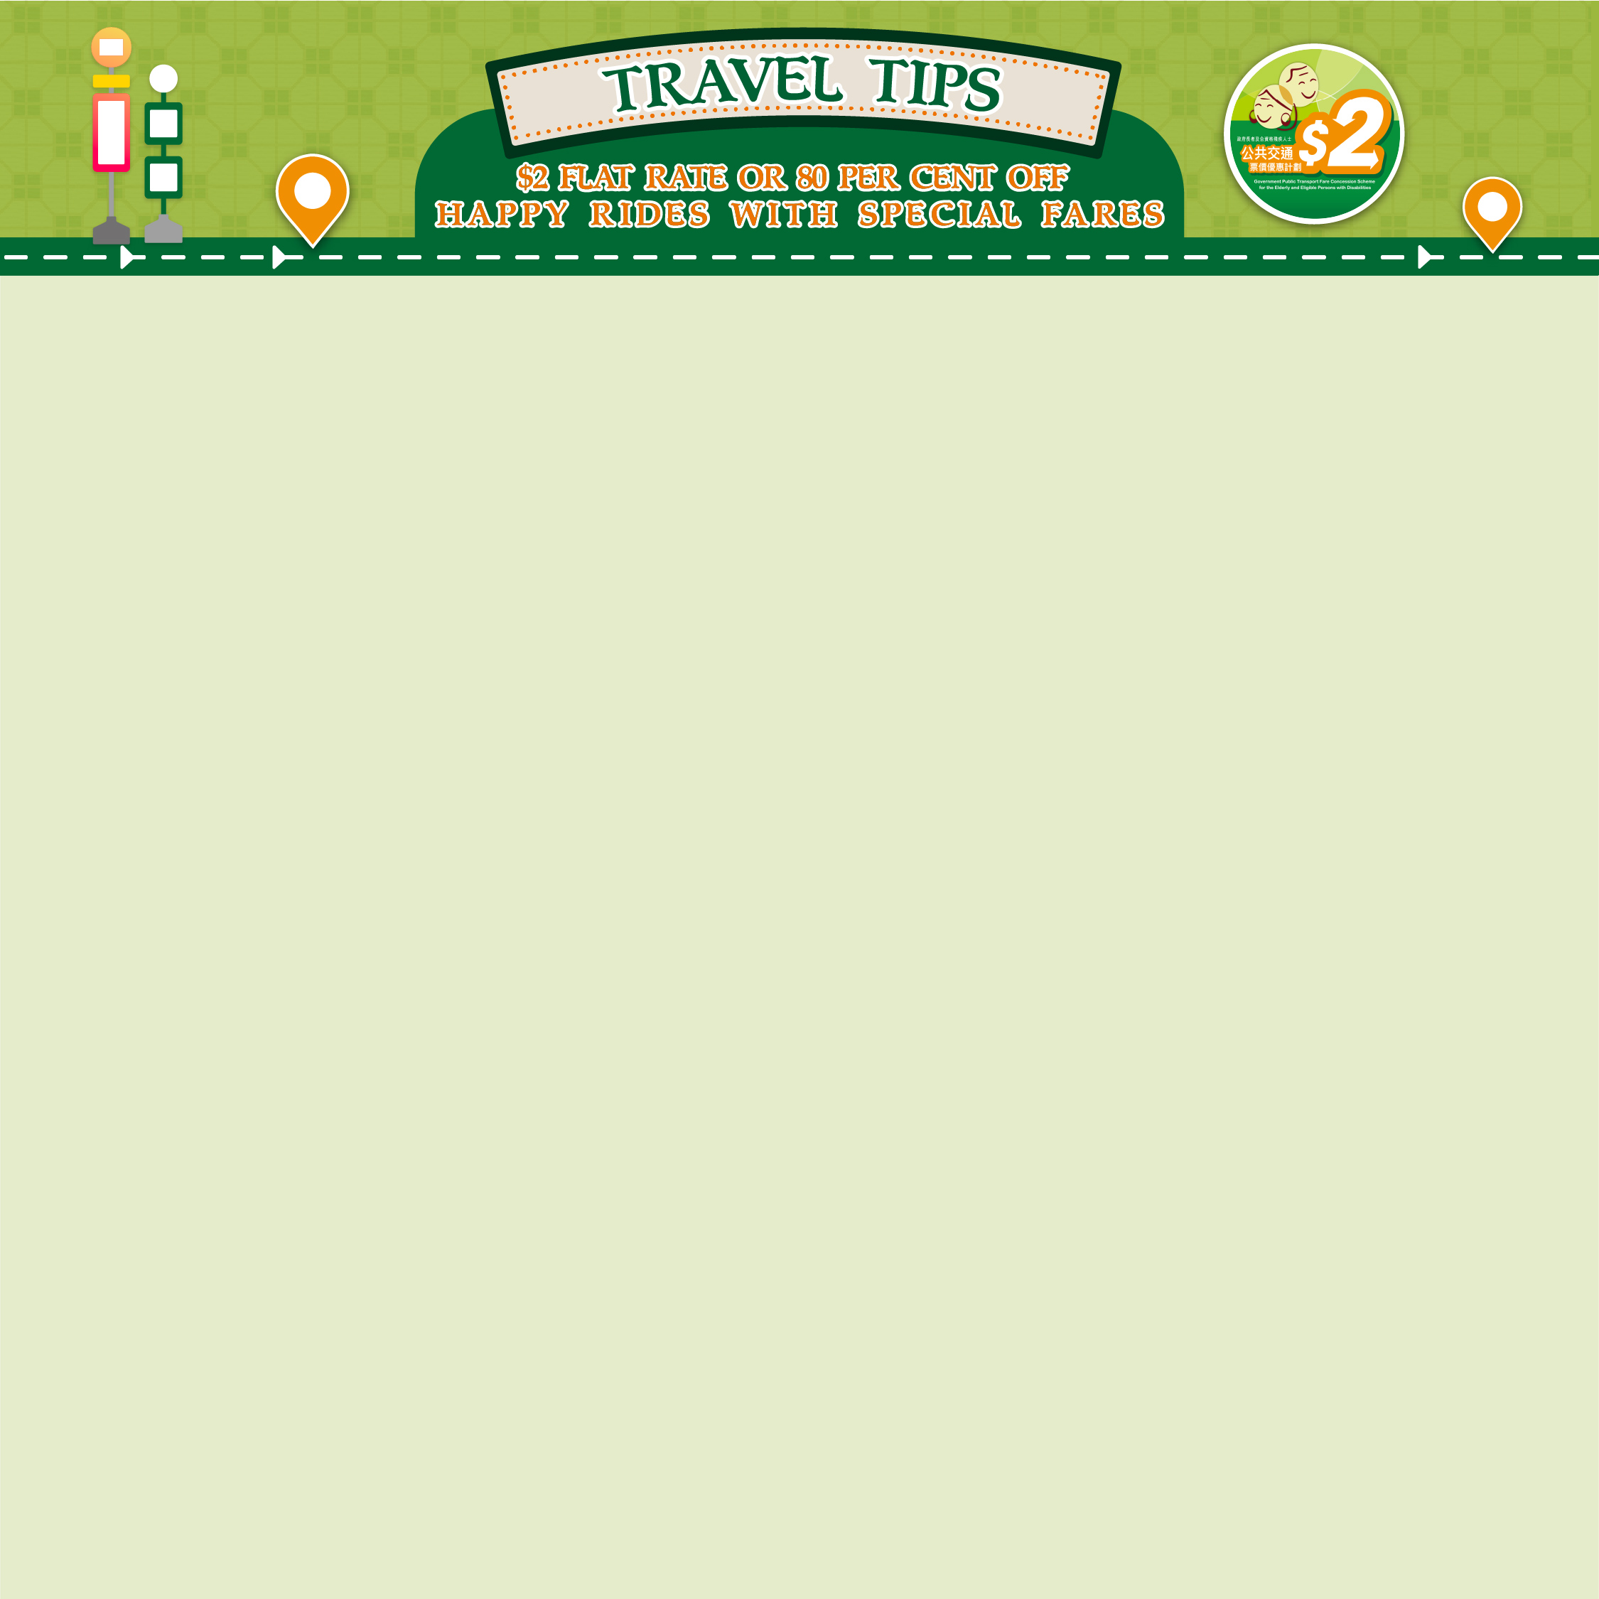



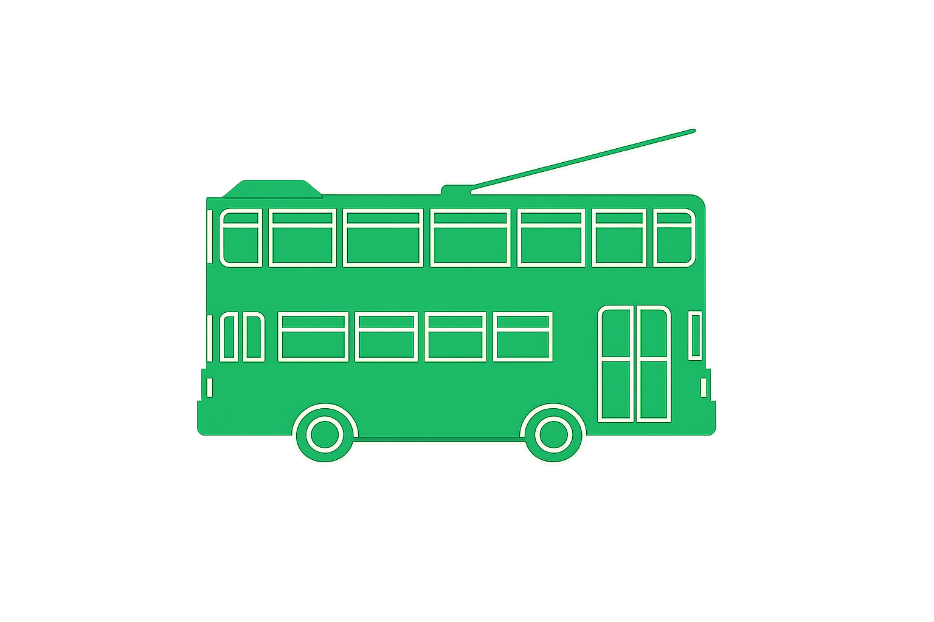
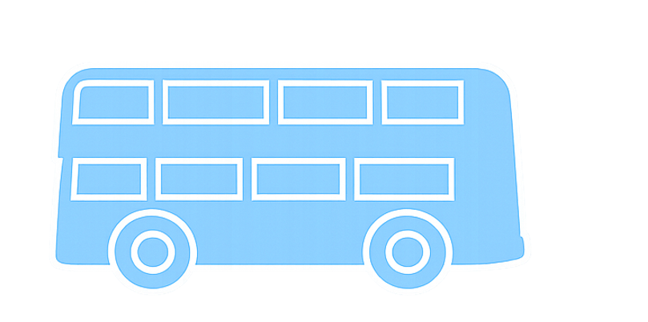
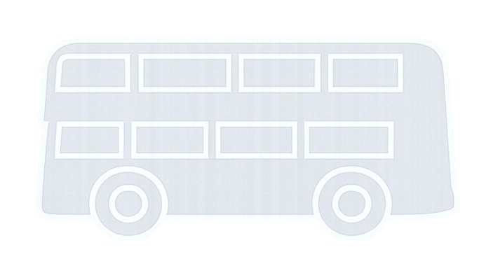




Hong Kong-Macao Ferry Terminal to United Centre
Save $2.2
Tram
1
2
182
MTR Hong Kong Station to Pacific Place
Save $3.6
Tram
1
5B
673
Kennedy Town Fire Station to Hong Kong-Macao Ferry Terminal
Save $0.6
5B
10
54
101
Central Market to Central Government Offices
Save $3.6
Tram
1
Island Line
673
Belcher Bay Park to Wing On Centre
Save $0.6
Tram
5B
10
101

Slide 2
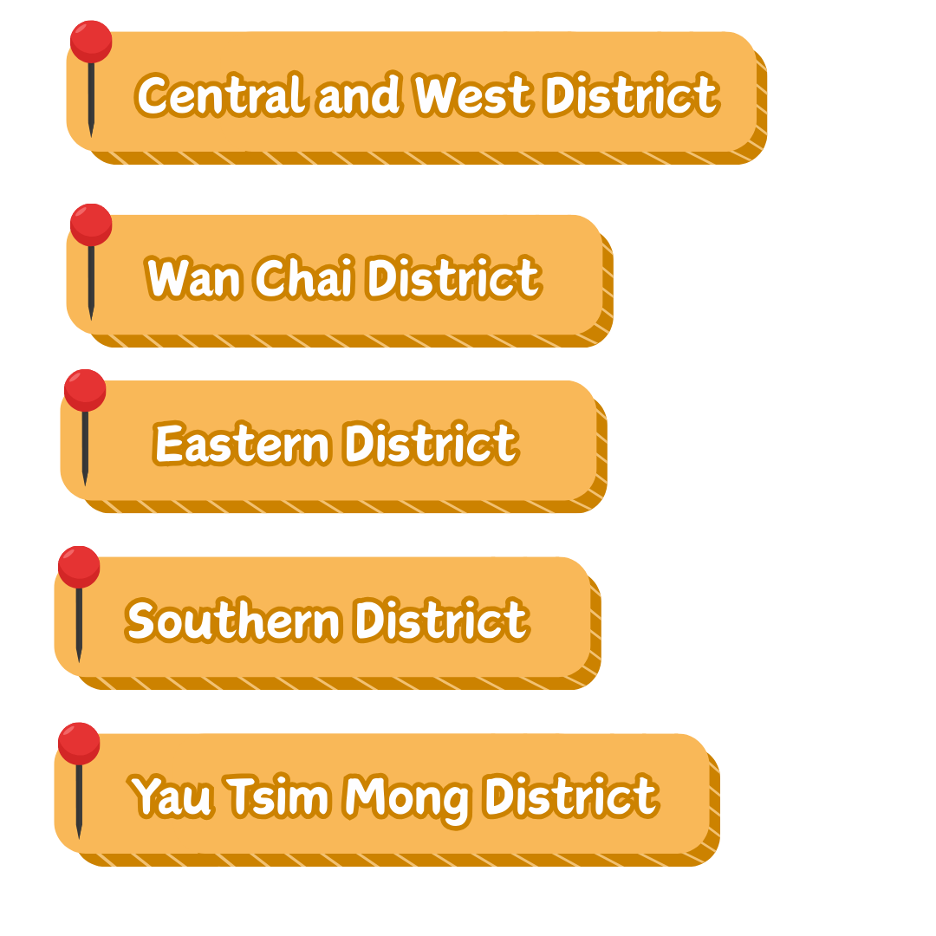
Wah Kwai Estate to Aberdeen
Save $0.9
70
78
51S
107
Cyberport to Wong Chuk Hang
Save $0.5
73*
69A
69X
Chi Fu Fa Yuen to Queen Mary Hospital
Save $0.9
37B
40
23M
970X
South Horizons to Wong Chuk Hang
Save $0.9
592
South Island Line
171
Wong Chuk Hang to Aberdeen
Save $1.0
37B
4M
973
* Passengers are required to make use of the front-part-journey section fare discount provided for the relevant section of the route.

Slide 3
Southorn Playground to Pacific Place
Save $2.8
Tram
1
5B
960
Yee Wo Street to Queen Street
Save $3.5
Tram
5B
26
969
Hong Kong Central Library to Yee Wo Street
Save $3.4
Tram
8
Island Line
968
Victoria Park to Island Place
Save $1.6
Tram
2
Island Line
690
King Kwong Street to Times Square
Save $0.4
Tram
8X
117

Slide 4
Yiu Tung Estate to Kornhill Plaza
Save $0.6
2A
99
722
606
Island Resort to Wan Tsui Shopping Centre
Save $3.5
8P
8X
82
976A
Shau Kei Wan Market to Sai Wan Ho Civic Centre
Save $0.9
2
2X
Island Line
33X
Fu Shing Court to Eastern Hospital
Save $2.9
8H
8X
47E
682
Kornhill Plaza to Island Place
Save $2.1
Tram
85/85A
Island Line
987

Slide 5
The Peninsula to Former Yau Ma Tei Police Station
Save $2.2
1
7
Tsuen Wan Line
269B
Park Avenue to Jordan Road
Save $0.4
12
78
914
Tsim Sha Tsui East to Middle Road
Save $0.3
208
8
98D
HSBC Centre to Langham Place
Save $1.4
Tung Chung and Tsuen Wan Line
12S
265B
Boundary Street to Yau Tsim Mong District Health Centre
Tsuen Wan/ Kwun Tong Line
Save $0.4
33A
37
905

Slide 6
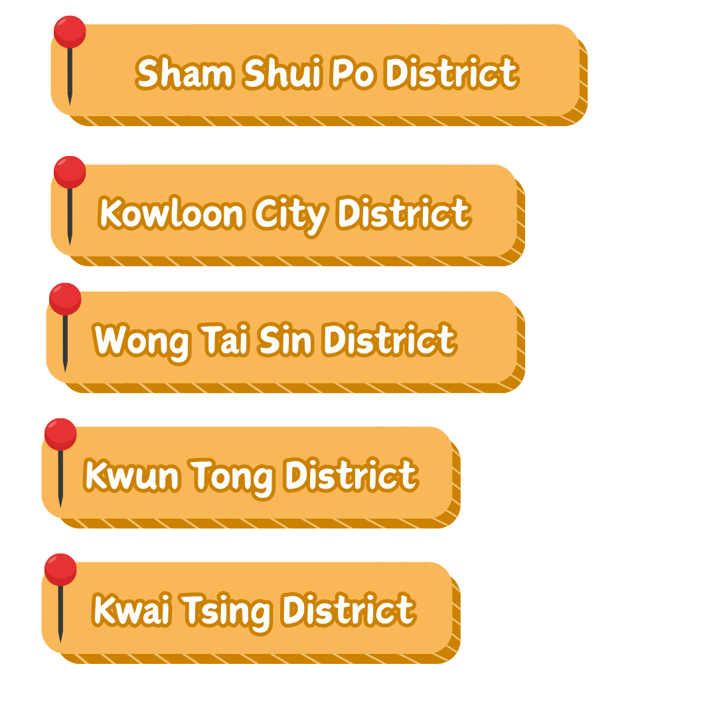
Lower Wong Tai Sin (2) Estate to Wang Tau Hom Estate
Save $1.7
3C
75X
E22
Tin Wang Court to MTR Lok Fu Station
Save $0.6
7M
53M
103
Fu Shan Estate to San Po Kong (Ning Yuen Street)
Save $0.6
3B
203E
116
Tsz Wan Shan (Central) to Tai Shing Street Market
Save $0.6
3B
5C
116
Choi Hung Estate to MTR Wong Tai Sin Station
Save $0.4
80
89
Kwun Tong Line
X42C

Slide 7
Hoi Lai Estate to MTR Nam Cheong Station
Save $0.9
12
701
971
Mei Foo Sun Chuen to Cheung Sha Wan Government Offices
Save $0.6
36A
42A
Tsuen Wan Line
102
Cheung Sha Wan to Mei Foo Sun Chuen
Save $0.9
6
6C
Tsuen Wan Line
59X
So Uk Estate to Cheung Sha Wan Government Offices
Save $0.9
2A
6
6C
970
Nob Hill to MTR Lai Chi Kok Station
Save $0.9
6
Tsuen Wan Line
171

Slide 8
Sau Mau Ping to Kwun Tong Town Centre
Save $0.6
11C
13M
34S
601
Shun Tin Estate/Shun Lee Estate to MTR Choi Hung Station
Save $1.7
27
29M
54M
E22P
Kwun Tong Town Centre to Diamond Hill
Save $1.8
11C
15A
Kwun Tong Line
62X
Lam Tin North to Kwun Tong Town Centre
Save $1.7
15
16M
63
E22
Yau Tong to Kwun Tong Town Centre
Save $1.8
14
14B
Kwun Tong Line
62X

Slide 9
AIRSIDE to Hung Hom
Save $0.9
5A
796X
Tuen Ma Line
107
Ma Tau Chung Road to Hung Hom
Save $1.7
3B
2
Tuen Ma Line
E23
Ho Man Tin Estate/Oi Man Estate to Hung Hom
Save $0.4
7B
8
8
109
Kai Ching Estate/Tak Long Estate to To Kwa Wan
Save $0.5
5D
22M
Tuen Ma Line
108
Grand Waterfront to Whampoa Garden
Save $0.4
5D
12A
115

Slide 10
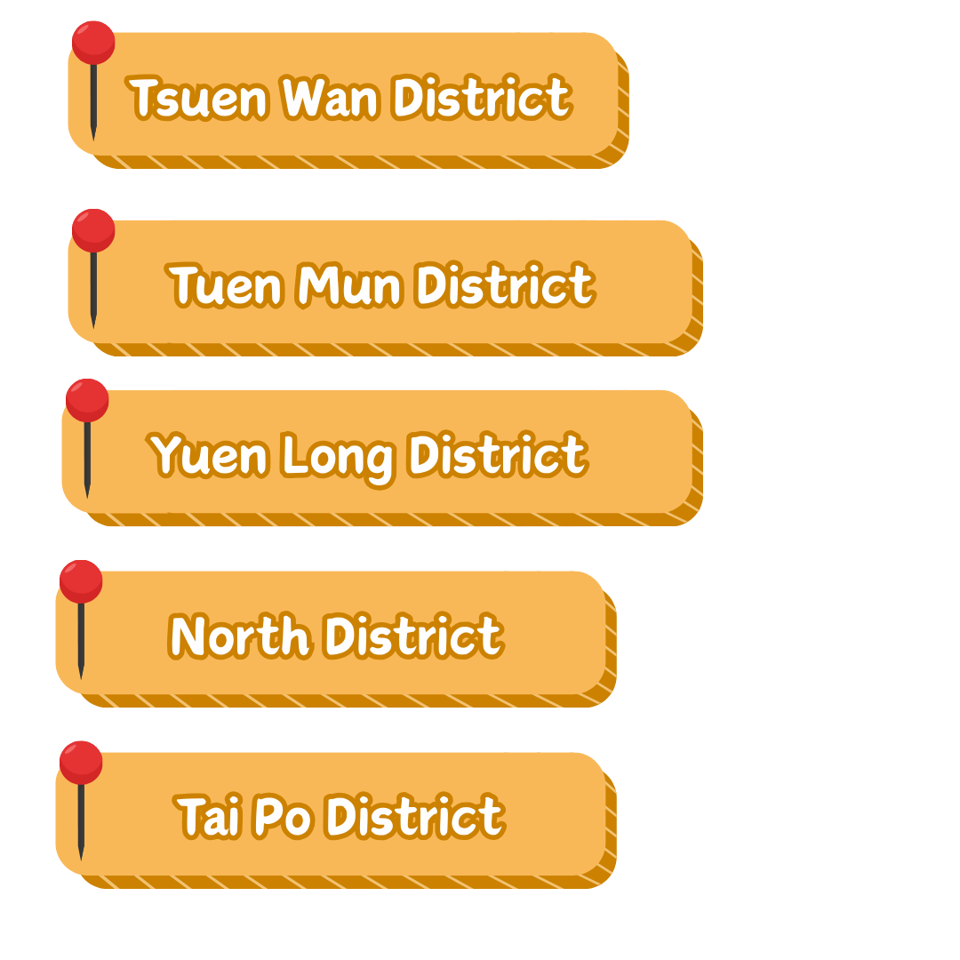

Castle Peak Road – Yuen Long to MTR Yuen Long Station
Save $3.4
K65
K74
610
968
Light Rail Hung Shui Kiu Station to Castle Peak Road – Yuen Long
Save $1.4
68X*
276P*
610
64X
Skylight Market to Kingswood Villas
Save $3.5
269D*
705
751
967
Tin Shui Estate to MTR Tin Shui Wai Station
Save $3.5
69M*
K75P
705
969
Tin Tsz Estate to Yuen Long West
Save $1.1
K73
K74
B1
* Passengers are required to make use of the front-part-journey section fare discount provided for the relevant section of the route.

Slide 11
Leung King Estate to Tuen Mun Town Plaza
Save $2.8
58M*
505
507
960
Tuen Mun Town Centre to MTR Yuen Long Station and Castle Peak Road – Yuen Long
Save $2.3
68A
Tuen Ma Line
B9
614
Yan Oi Market to Hong Kong Gold Coast
Save $2.8
K51
K51A
K53
952
Lung Mun Oasis to Yan Oi Market
Save $2.8
K52
962X
Tuen Mun Ferry Pier to Tuen Mun Town Centre
Save $1.3
506
K52
507
B3
* Passengers are required to make use of the front-part-journey section fare discount provided for the relevant section of the route.

Slide 12
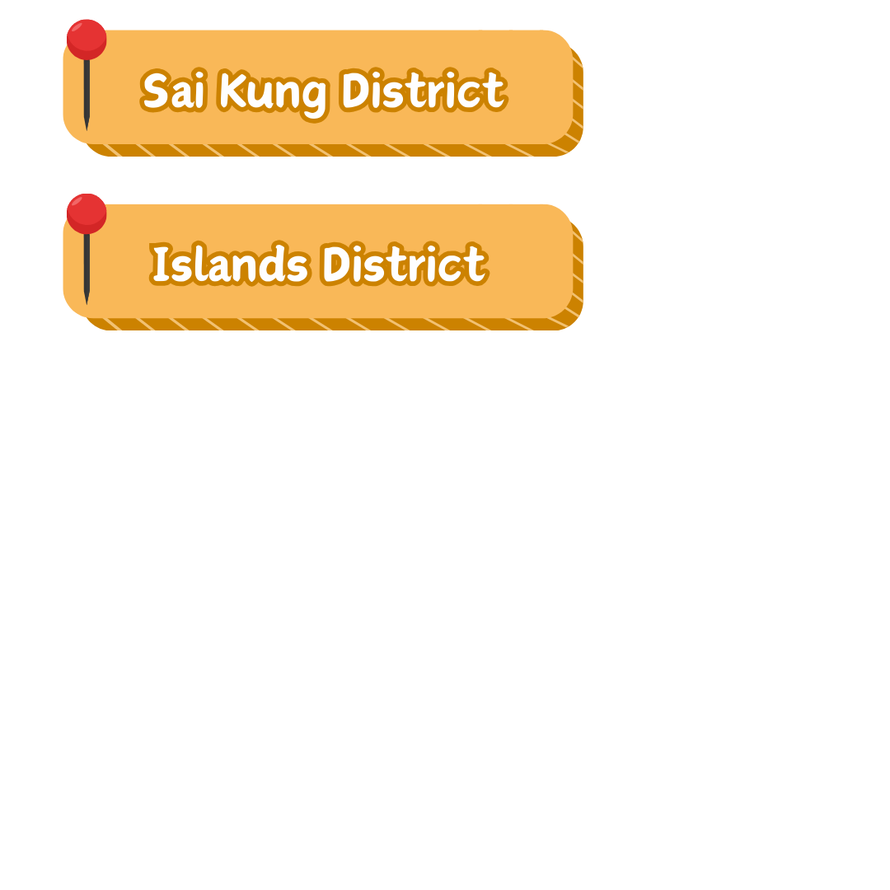
Tung Chung Town Centre to Tung Chung North
Save $2.3
37A
37H
37M
E11A
Yat Tung Estate/ Mun Tung Estate to Tung Chung North
Save $0.9
37
37H
37P
E36A
Yat Tung Estate/ Mun Tung Estate to Tung Chung Town Centre
Save $0.2
37H
38
39M
E31
Tung Chung Town Centre to Tung Chung West (Tung Chung Road)
Save $2.1 (Mons – Sats)/
$5.4 (Suns & PHs)
34
23
Airport to Tung Chung Town Centre
Save $3.0
S1
S64
E22A

Slide 13
Cheung Hang Estate to Cheung On Estate
Save $0.2
42M
248M
409
42C
Greenfield Garden to Cheung Ching Estate
Save $2.2
243M
88D
948
MTR Tsing Yi Station to Cheung Hang Estate
Save $1.4
248M
409
279X
Tai Wo Hau Estate to Metroplaza
Save $2.2
32H
43
930
Kwai Shing West Estate to MTR Kwai Hing Station
Save $0.2
37M
38P

Slide 14
Shek Wai Kok to Lei Muk Shue
Save $2.1
32
94
312
936
Bayview Garden to Discovery Park
Save $2.1
34
234B
96B
934
Discovery Park to Tsuen Wan Town Centre
Save $2.2
39A
243M
95
930X
Sham Tseng to Tsuen King Circuit
Save $0.4
234A
234B
96M
234D
Tsuen Wan West to Tai Wo Hau
Save $2.2
31
43B
86
930

Slide 15
Wo Muk Road Playground to Cheung Wah Estate
Save $1.4
70K
78K
277X
Tsui Lai Garden to Fanling Town Centre
Save $0.3
70K
79K
B7
Cheerful Park to MTR Fanling Station
Save $0.8
273A
273D
502
Ching Ho Estate to Landmark North
Save $3.6
270B
273A
273B
978
Landmark North to Tin Ping Estate
Save $3.6
56
270
277E
673

Slide 16
Ying Ming Court to East Point City
Save $3.0
98C
296M
15
E22A
Oscar by the Sea to LOHAS Park
Save $1.6
290X
793
796X
690S
Tiu Keng Leng (Choi Ming) to Hang Hau
Save $1.6
290A*
E22A
108A
694
Hong Sing Garden to MTR Po Lam Station
Save $3.0
296M
15
111
E22A
MTR Tiu Keng Leng Station to Sheung Tak Estate
Save $3.0
793
796X
798*
E22A
* Passengers are required to make use of the front-part-journey section fare discount provided for the relevant section of the route.

Slide 17
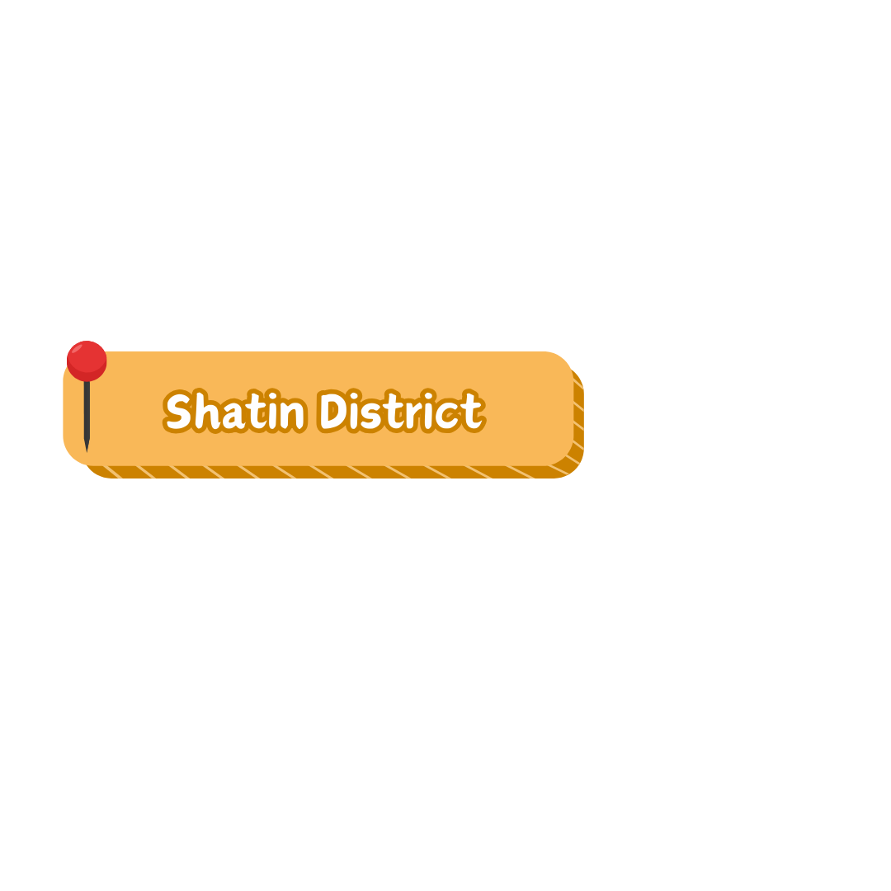
Chun Yeung Estate to Sha Tin Town Centre
Save $0.6
285
60K
60P
798
Tai Chung Kiu Road to Sun Chui Estate
Save $2.2
803
804
182
Sha Kok Estate to Sha Tin Town Centre
Save $0.9
81K
83S
288
E42
Tai Shui Hang to City One Sha Tin
Save $2.9
85K
86K
810
680
MOSTown to Kam Chun Court
Save $2.9
86K
87K
808
682

Slide 18
Lam Tsuen to Tai Po Town Centre
Save $1.0
64K
65K
25K
T74
Tai Po Industrial Estate to Kwong Fuk Estate
Save $2.2
72A
75K
26*
263C
Tai Wo to Kwong Fuk Road
Save $0.4
64K
73
25K
74A
* Passengers are required to make use of the front-part-journey section fare discount provided for the relevant section of the route.

